Slide 1
Bring your learning into FOCUS
Notes:
FOCUS is a brand new course for upper secondary
5 Levels
Aims to prepare students for their end of school exams

Slide 2
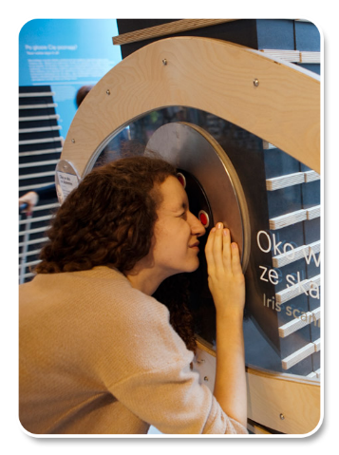
What is it?
Upper secondary school students
State and private schools
Exams oriented
15 – 19 year olds
Five-level course (Elem - Advanced)
100 - 120 hours per level
British English (the four-level American edition will be completed in September 2016)
A2 – C1
3/5h week

Slide 3
Who is it for?
Teachers who want to:
Track their students’ detailed progress against desired learning outcomes
Motivate students to achieve their potential in end of school and high stakes exams
Keep large, differentiated classes of students engaged and motivated
Students who:
Are looking for a course that allows them to decide how much digital or paper-based content they use
Want to progress to tertiary/professional education
Want relevant, up-to-date content – most courses are boring
Want immediate extra support in the panic weeks before exams
Notes:
Focus has been written with these key points in mind

Slide 4
Authors
Sue Kay
Vaughan Jones
(New Inside Out authors)
Notes:
Thinking about Campaigns/Launch – are the authors known in your market?
Sue Kay started her career in ELT in Lyons, France and then returned to the UK where she worked as a director of the Lake School of English in Oxford, her first writing project was the Reward Resource Packs published by Heinemann and written to accompany the best-selling course, Reward. Since then she has been involved in various writing projects with co-author Vaughan Jones, notably Inside Out and New Inside Out published by Macmillan and Focus, published by Pearson.
Vaughan Jones has been involved in English language teaching, training and materials writing for over 30 years. He has lived and working in France, Japan and Spain and given workshops to teachers all over the world. He is co-author, with Sue Kay, of various coursebooks including the Inside Out series for Macmillan and Focus, published by Pearson. He lives near Oxford where he divides his time between materials development, teaching and a hectic family life.

Slide 5
Focus is… the 3 M’s – course methodology
Mo
Meaning
Motivation
Me
Me
Memory

Slide 6
Focus is… the 3 M’s – course methodology
What are the 3 Ms?
Motivation – Engaging content
Language is brought to life through engaging contexts, grammar animations and interactive speaking videos.
Memory – Repeated exposure
Language acquisition is driven by careful recycling of vocabulary and grammar.
Meaning – Meaningful practice
English is made relevant to students’ lives through frequent personalisation.

Slide 7
Motivation - topic Houses (level 2)
The house in FOCUS
Typical course

Slide 8
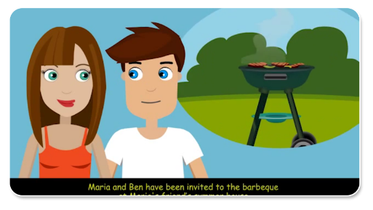
Motivation
Grammar animations
New functional
interactive videos

Slide 9
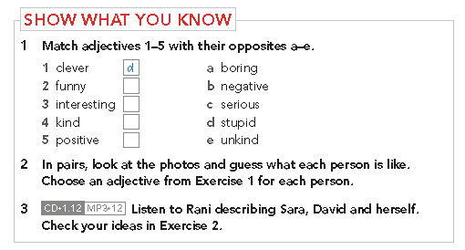
Memory - unique vocabulary development in 3 steps
Step 1: Show them how much they already know
SB – Intro Unit
Workbook

Slide 10
Memory - unique vocabulary development in 3 steps
Step 2: Develop students’ vocabulary
Show What
You Have Learnt
Word Store
C
Word Store
B
Word Store
A
Show What
You Know
Notes:
The Students’ Book includes a 24-page Word store booklet at the back that provides extensive vocabulary practice specific to the vocabulary lesson of each unit.
The Word Store is an opportunity to practise the vocabulary in an even more comprehensive way. By activating one more skill - the rewriting of each item while doing an exercise - students have one more chance to memorise the words. Students physically activate their fingers and pen/pencil – a recommended method for retention - one needs to listen, repeat, use in context and write and this should in fact happen a number of times for students to memorize an item.
On top of that, once students do all exercises they have compiled their own mini-dictionary of words they should learn in each level. These serve as help for the Show What You Know sections in the upper levels.
The unique design of the booklet allows the page in the Word Store to match up with the relevant page in the Students’ Book to form an extended lesson spread. A student can open out the relevant page of the Word Store booklet while they are completing the unit, so they can easily access their extra vocabulary practice.
Please see the Product Walkthrough section to see an example of how the Word Store and the Students’ Book work together.

Slide 11
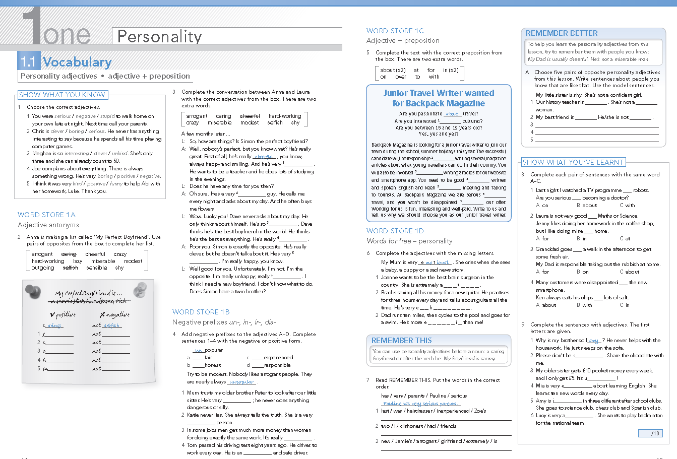
Memory - unique vocabulary development in 3 steps
Step 3: Show them what they have learnt (WB)

Slide 12
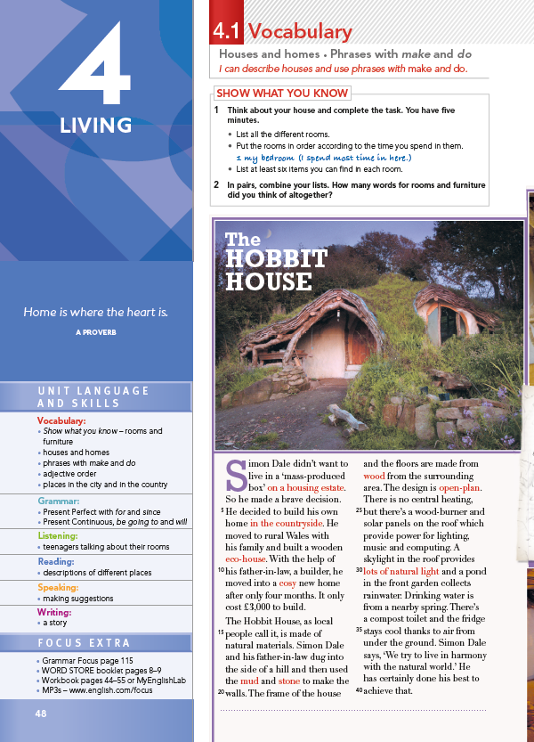
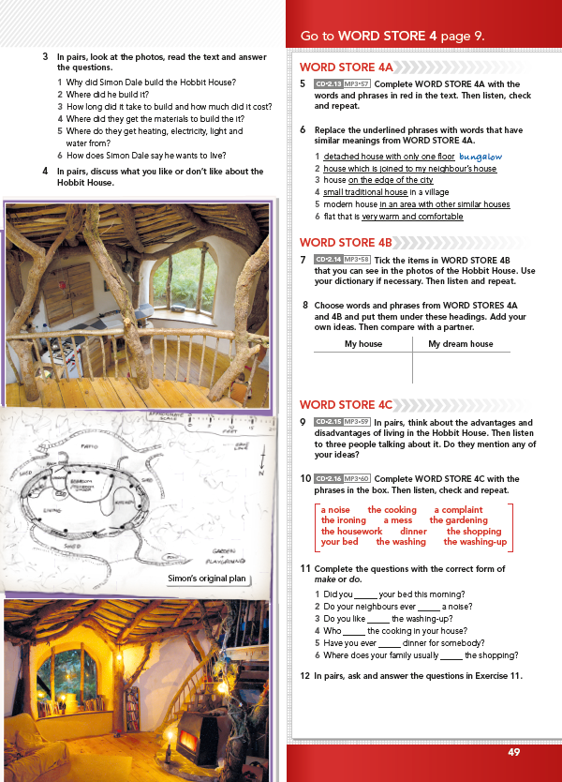
Memory - unique vocabulary development in 3 steps
Unique approach to vocabulary learning with the Word Store, extra vocabulary practice booklet and exercises for each unit

Slide 13
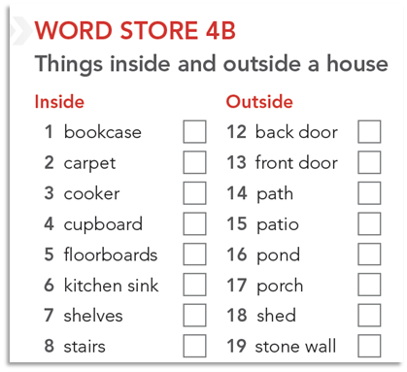
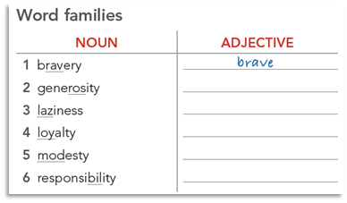
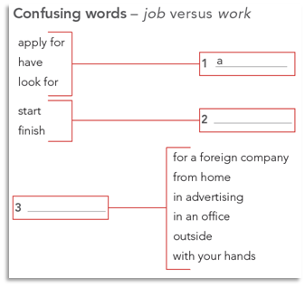
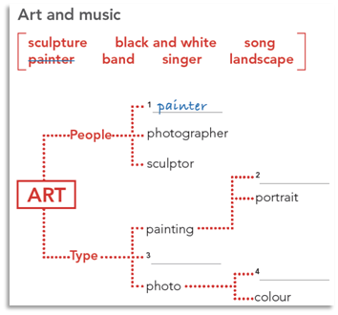
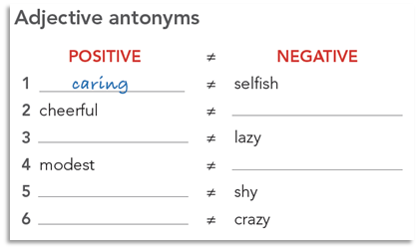
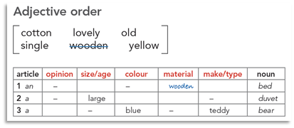
Memory - WORD STORE - how words are recorded

Slide 14
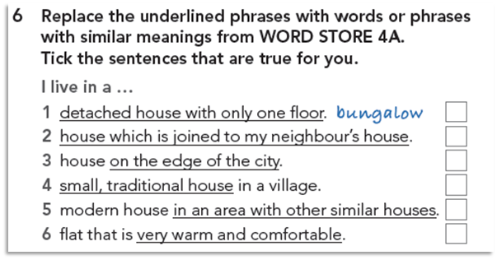
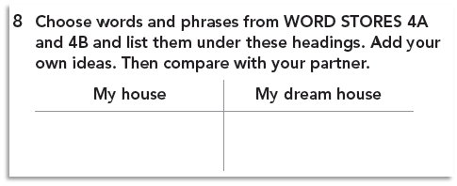
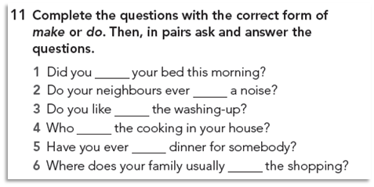
Meaning

Slide 15
Meaningful Practice
Digital, detailed results for each student through MyEnglishLab

Slide 16
Unit walkthrough

Slide 17
FOCUS – Unit Walkthrough
One page = one lesson layout eliminates wasted space and helps navigate the unit
Colour coded sections make teachers’ and students’ lives easier

Slide 18
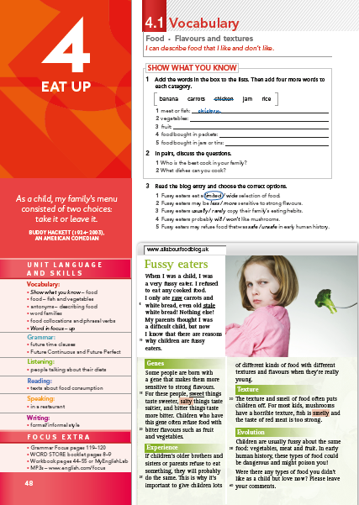
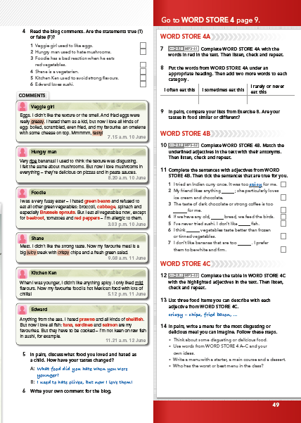
Word Store extra vocab practice prompts throughout the unit
‘Show what you know’ section to help place students and personalise learning
FOCUS - Unit Walkthrough
Lesson 1 - Vocabulary
Intriguing quote to set the scene for the unit
Unit roadmap to build students’ confidence when preparing for the unit
Focus Extra points to all the extra practice that’s relevant to the unit

Slide 19
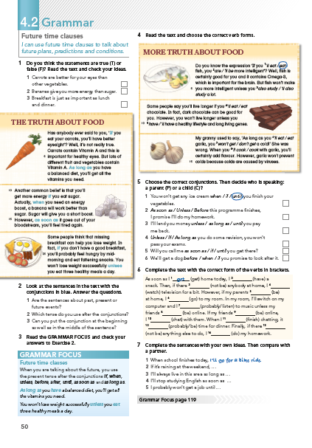
FOCUS - Unit Walkthrough Lesson 2 – Grammar 1
Two grammar lessons in each unit
Students relate material to their own experiences
Grammar Focus section explains grammar rules clearly for easy reference

Slide 20
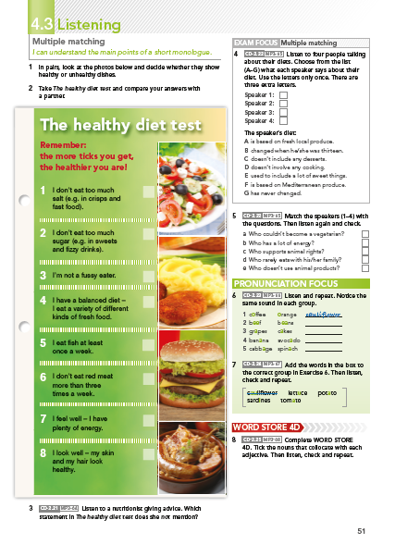
FOCUS - Unit Walkthrough Lesson 3 - Listening
Exam Focus section models exam-style questions, audio and text
Pronunciation Focus section to help students’ confidence with key vocab
Word Store extra vocab practice prompts throughout the unit

Slide 21
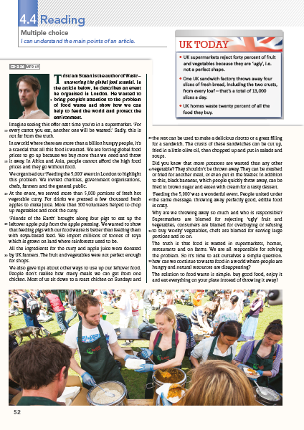
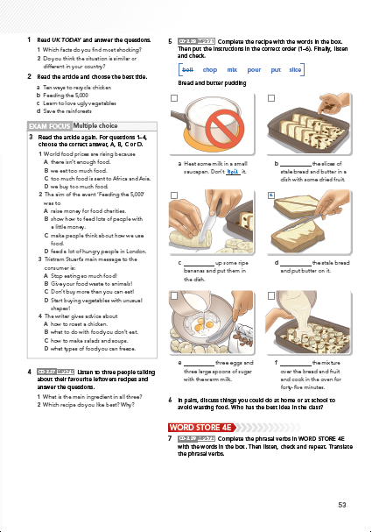
FOCUS - Unit Walkthrough Lesson 4 - Reading
Text lengths mirror those in relevant exams
Word Store extra vocab practice prompts throughout the unit
Age-appropriate content from British and American cultural backgrounds that will engage teenagers
Exam Focus sections occur in all 4 skills lessons for different task types

Slide 22
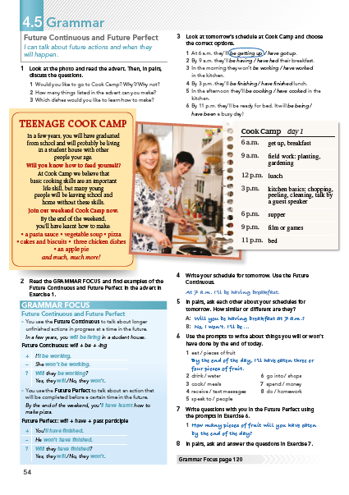
FOCUS - Unit Walkthrough Lesson 5 – Grammar 2
Two grammar lessons in each unit

Slide 23
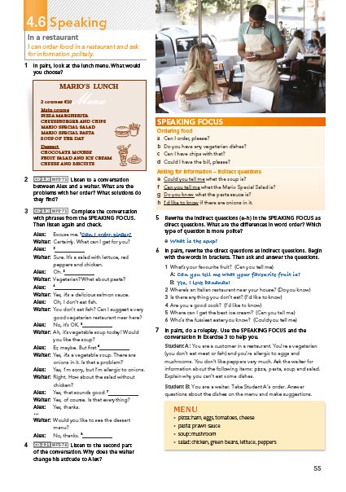
FOCUS - Unit Walkthrough Lesson 6 – Speaking
Speaking Focus section contains helpful phrase modelling for the content covered in the unit
Speaking Focus content is referred to and recycled within the lesson

Slide 24
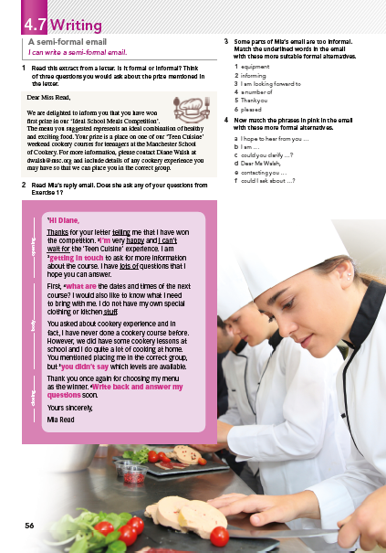
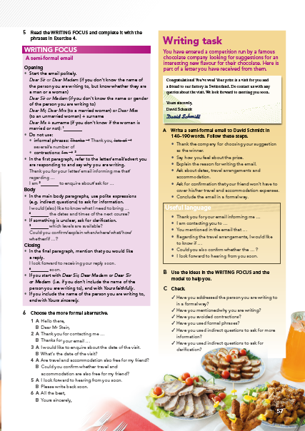
FOCUS - Unit Walkthrough Lesson 7 – Writing
Writing Focus sections model contains useful phrase modelling for material covered in the unit
Writing Focus content is recycled throughout the lesson
Print and digital text types are covered

Slide 25
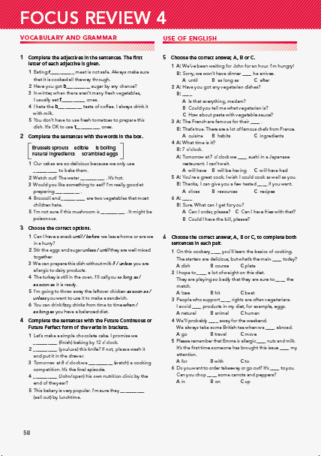
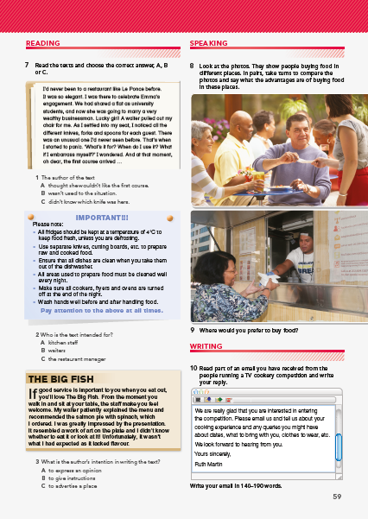
FOCUS - Unit Walkthrough Lesson 8 – Revision

Slide 26
Memory - unique vocabulary development in 3 steps
Show What
You Have Learnt
Word Store
C
Word Store
B
Word Store
A
Show What
You Know

Slide 27
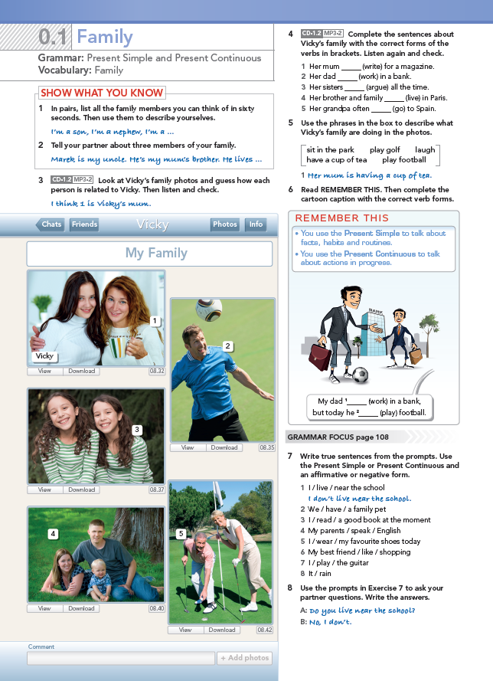
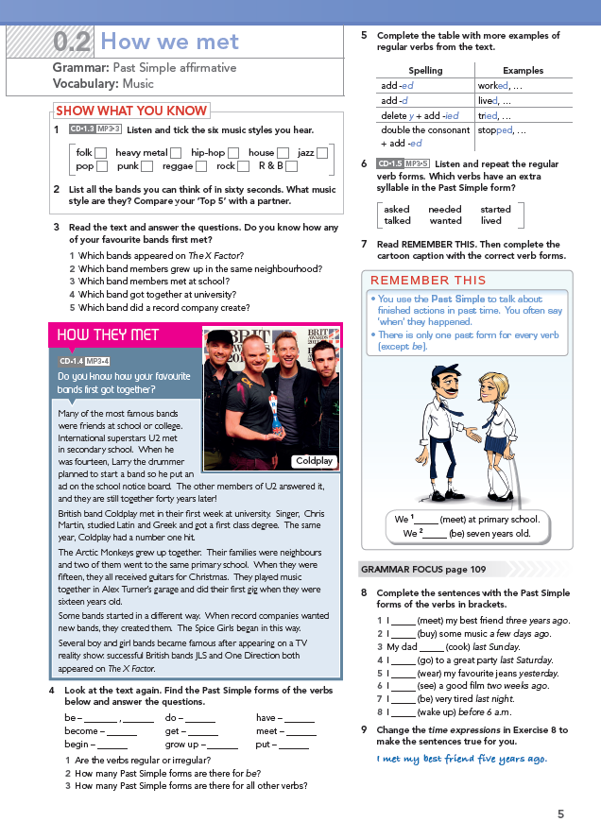
USP - unique grammar development in 3 steps
Step 1: Show students how much they already know

Slide 28
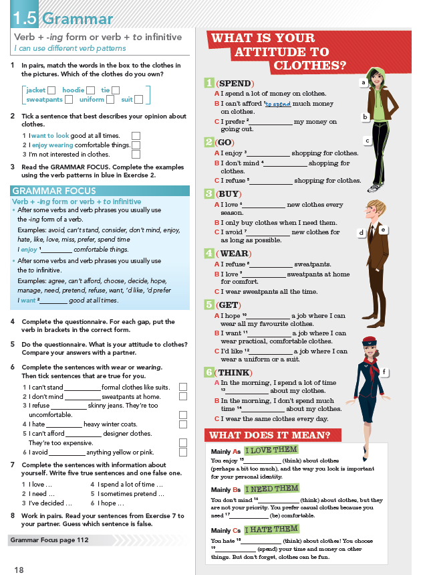
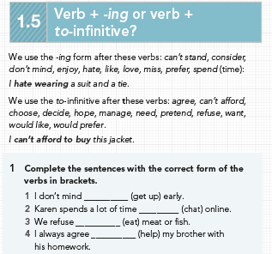
USP - unique grammar development in 3 steps
Step 2: Teach them in an engaging way
Engaging context
Grammar box
Grammar reference and practice
at the back

Slide 29
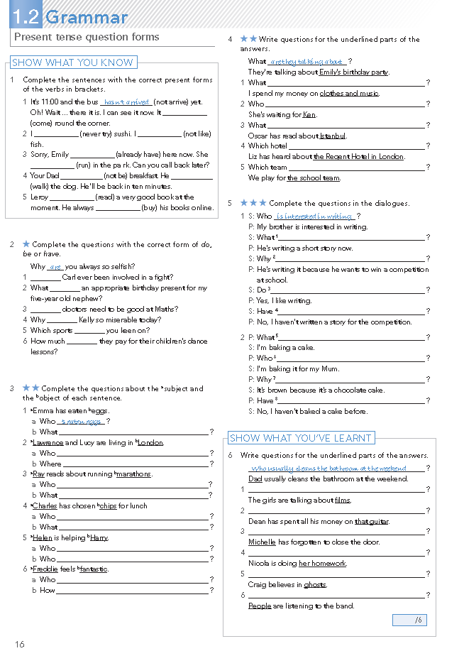
USP - unique grammar development in 3 steps
Step 3: Show them what they have learnt (WB Grammar)

Slide 30
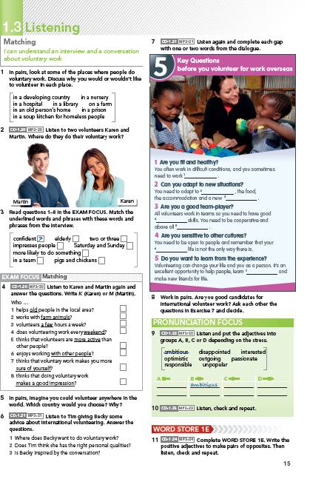
Exam in FOCUS – reading and listening

Slide 31
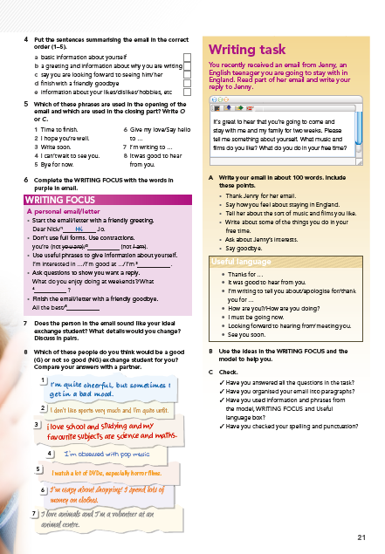
Exam in FOCUS – writing

Slide 32
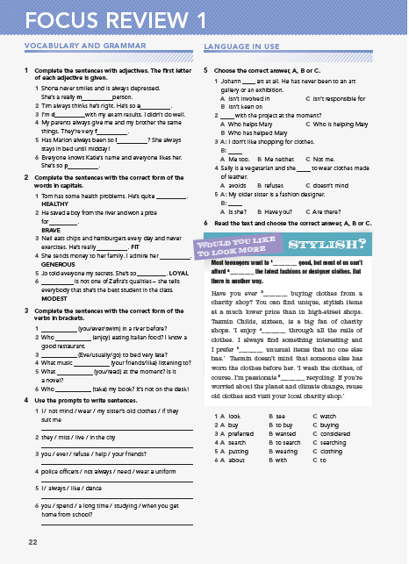
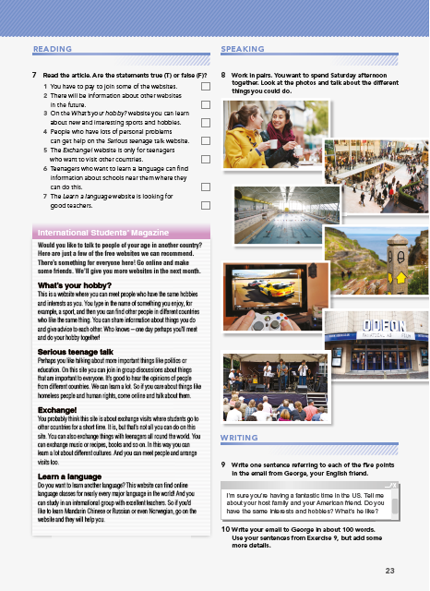
Exam in FOCUS – each unit

Slide 33
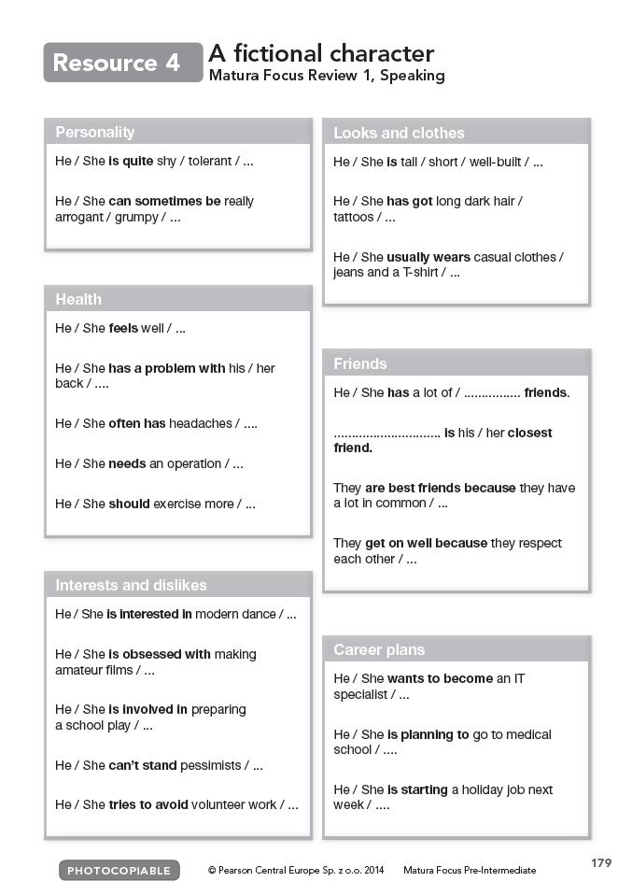
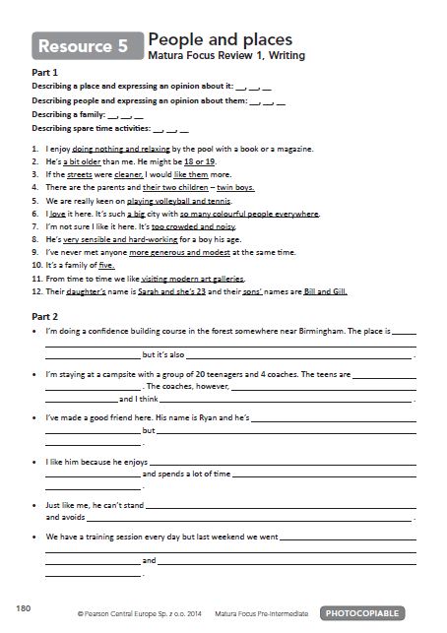
Exam in FOCUS – Teacher’s support (TB)
Photocopiable with practical support for
the Speaking and Writing productive skills

Slide 34
Testing in FOCUS
10-min tests for each vocab lesson
10-min tests for each grammar lesson
45-min Unit tests
Oral Exam Speaking programme
And other tests: semester, placement etc.

Slide 35
Focus components
Student’s Book
Workbook
Teacher’s Book
Class Audio CDs
Teacher’s DVD-ROM
Cambridge Exam Practice booklet
MyEnglishLab
ActiveTeach
Video: functional and grammar (1-4 only)
Tests
Newsfeed service

Slide 36
FOCUS components for Students
Student’s Book
· Course structure
· Exam style Review
Wordlists
Grammar Reference
Practice section
· Wordlists
· Unit Reviews and in-lesson
Exam Focus complied with Cambridge ESOL exams.
· Word Store booklet
Audio recordings for Student’s Book
www.English.com/Focus
Notes:
The course structure is modular, comprising eight units (nine in level 5) of 12 pages with one or two page lessons
· Every unit is followed by a double page exam style ‘review’.
· There are Wordlists and a Grammar Reference and Practice section at the back.
· Wordlists in the back of the book.
· Unit Reviews and in-lesson Exam Focus complied with Cambridge ESOL exams.
· includes a 24-page Word Store booklet at the back, which provides extensive vocabulary practice specific to the vocabulary lesson of each unit. The unique design of the booklet allows the page in the Word Store to match up with the relevant page in the Students’ Book to form an extended lesson spread.
Audio recordings for Student’s Book
www.English.com/Focus

Slide 37
FOCUS components for Students
Workbook
· More specific exam style practice (Cambridge ESOL)
· Exam strategies
· Topic Word list
Exam Practice Booklet
· Focus Practice Tests Plus booklets available for Cambridge exams
· 2 practice tests in each book
· Exam guidance, tips and strategies for each exam

Slide 38
FOCUS components for Teachers
Teacher’s Book
· Includes full Student’s Book pages in colour, with answers, practical teaching tips and extra resources to supplement each unit.
· 24 page Word Store booklet
· GSE Can-Do statements and score bands
· Suggested opportunities for pair work and peer assessment
· Notes for interactive video
Multi-Rom
· Functional grammar videos + worksheets
· Interactive Speaking videos
· Photocopiable materials
· Test programme
Class Audio CDs
· Contains all the listening activities in the Student’s Book

Slide 39
FOCUS Teacher’s Book - Friend at Hand
Sample
answer
Teacher’s help

Slide 40
FOCUS components for Teachers
ActiveTeach
Offline only tool with links to video, grammar animations and teacher resources
Grammar and vocabulary games
Answers to all exercises

Slide 41
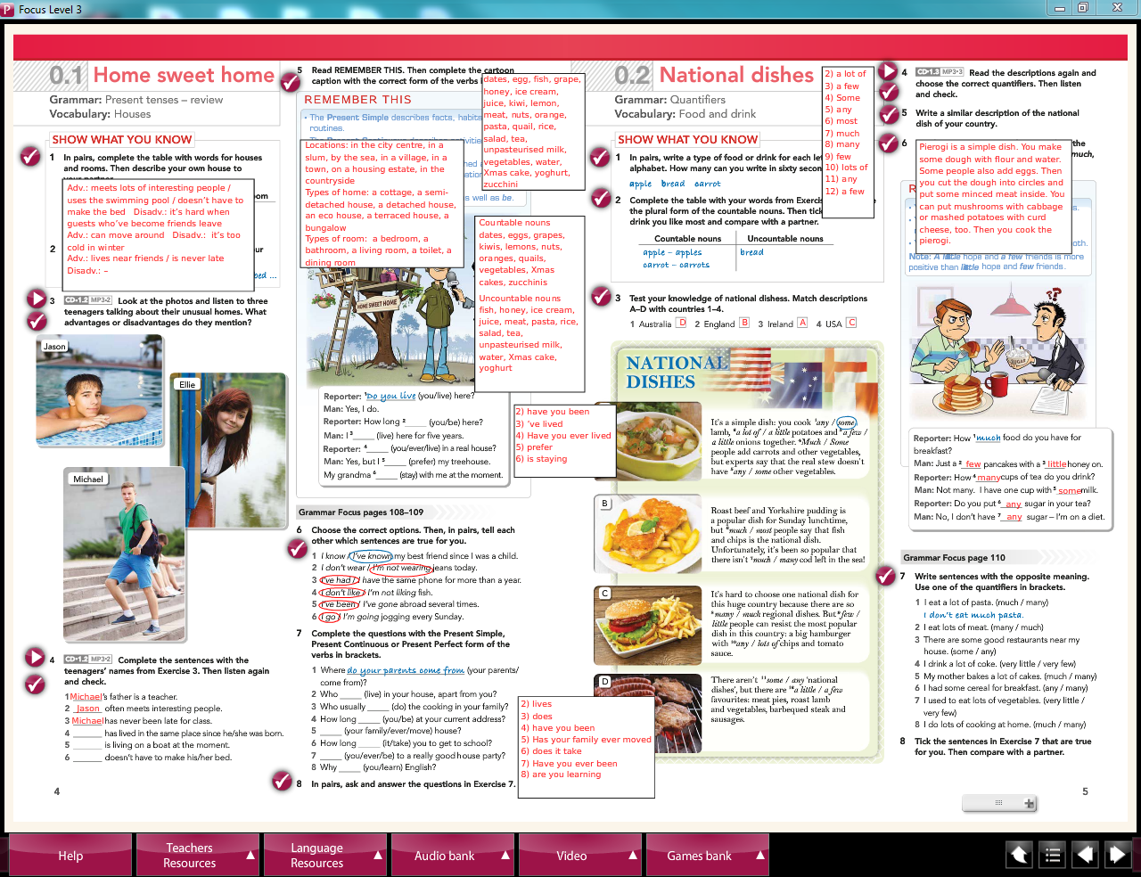

Slide 42
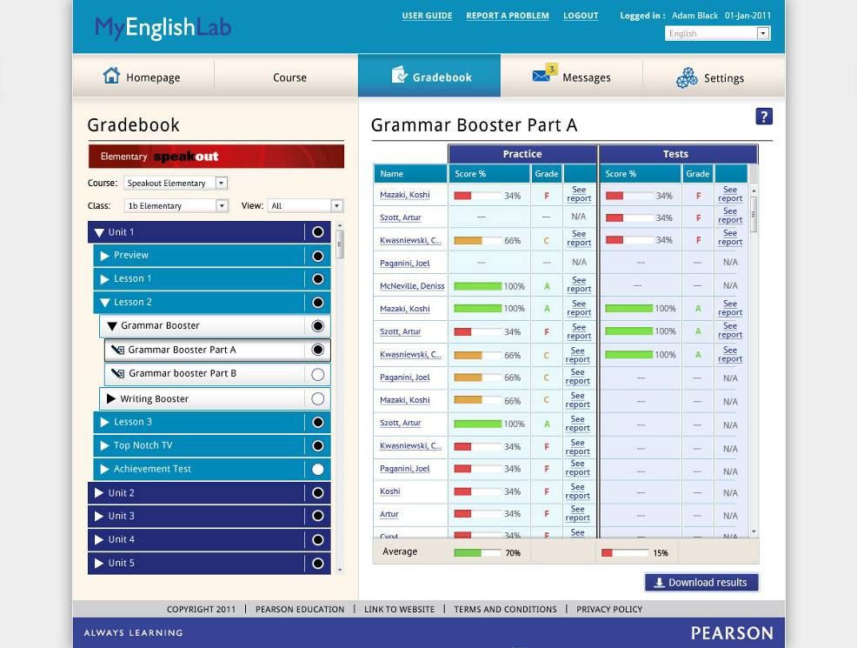

Slide 43
MyEnglishLab
An online practice and testing system:
Range of interactive activities, tasks and tests integrated with your core syllabus
Deeper insight into student development
Instant reporting for informed teaching
Teacher-controlled class assignments
More time for interaction in the classroom
Meaningful, motivating homework for teenagers
Hints, tips and extra material

